Slide 1


Titolo presentazione sottotitolo
RecSys Challenge
Milano, XX mese 20XX
Carlo Sgaravatti - Saverio Maggese

Slide 2
Roadmap
Data Exploration
Single Recommenders Hyperparameters Tuning
SLIM Elastic, P3 alpha, RP3 beta, …
Hybrid Recommenders
Linear Combination
Pipelines
List Combination
XGBoost/Catboost/LightGBM Ranker
Best MAP@10:
0.1380 (public),
0.13689 (private)
Best MAP@10:
0.13920 (public),
0.13874 (private)
Final Submission MAP@10:
0.14396 (public),
0.14431 (private)
Best Private MAP@10:
0.14488

Slide 3
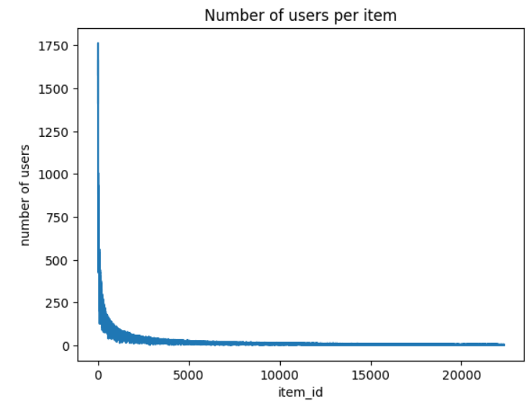

Data Exploration
Implicit Ratings URM-Pure Collaborative
22.347 items
13.024 users
Notes:
By exploring the interactions between users and items it was clear that there was a high popularity bias, since only a few items had the greatest number of interactions with the users.

Slide 4
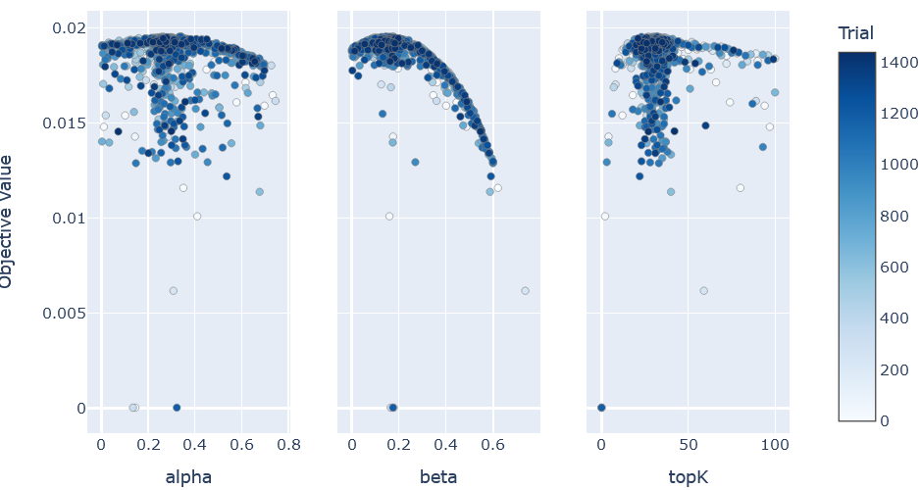
Single Recommenders Hyperparameter Tuning
Optuna
Intense hyperparameter tuning
Top Recommenders:
Slim Elasticnet
RP3Beta
ItemKNN
Worse Recommenders:
NMF
SlimBPR
LightFM
Notes:
The first step was to perform hyperparameter tuning on the single recommender algorithms to make sure that we knew which were the best performing algorithm. We have used optuna together with a database to store the trials. For example here we put the results of RP3 beta tuning, where it seems clear which are the best hyperparameters for this problem. We looked to similar patterns also for the other recommenders to know when to stop the tuning process.

Slide 5
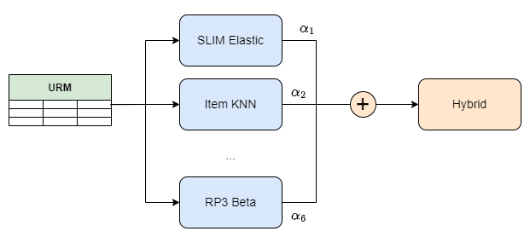
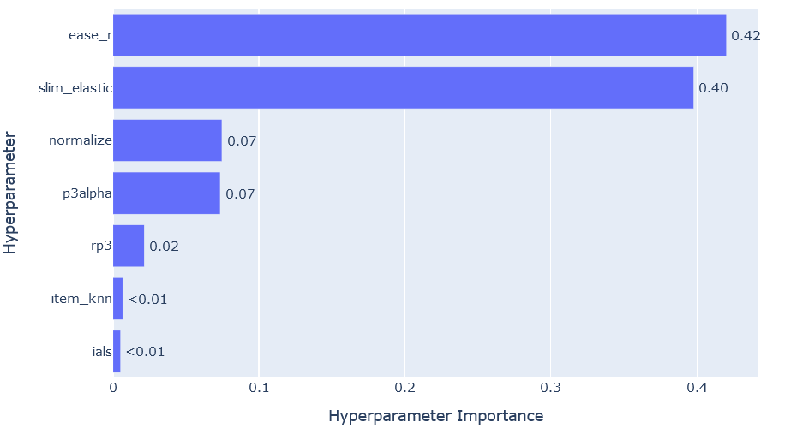
Hybrid Recommenders
(Normalized) Linear Combination:
Best public MAP@10: 0.1392 (SLIM Elastic + RP3 Beta + P3 alpha + Item KNN + IALS + EASE R)
Pipelines:
Best public MAP@10: 0.1384 (RP3 Beta + SLIM Elastic)
List combination (Round Robin, Ranking)
Best public MAP@10: 0.13868 (Ranking of RP3 Beta + SLIM Elastic)
which type of normalization to use (l1, l2 or linf)
Notes:
Once we realized which where the best recommenders, we first tried to build some hybrid recommender systems. We tried Linear combinations, Pipelines and List combinations. The best performing ones were linear combinations, where we used 6 recommenders for them (nomi recommenders …). For each hybrid we also performed hyperparameters tuning to determine the best weights for the hybrid, and to select a proper normalization among l1, l2 and linf to put together the scores of the recommenders.

Slide 6
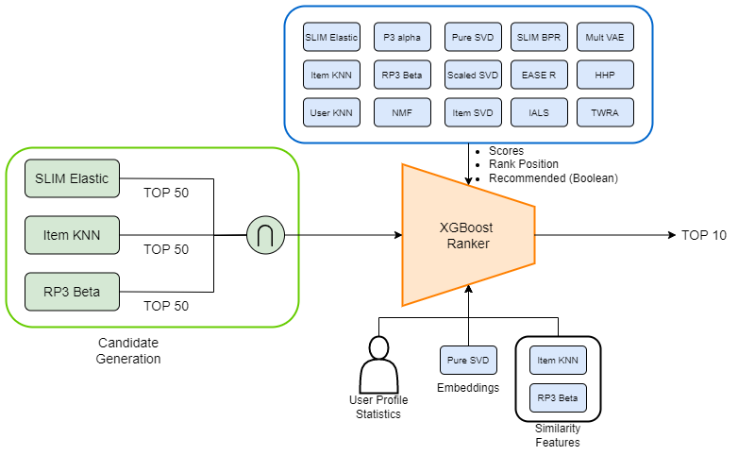
Final solution - The architecture
Tuned to maximize map@10
3 features per recommender
Rank positions are also aggregated (mean, std, skew, kurtosis)
Recommended feature is also summed
Between 50 and 150 candidates
Total of 78 features
Tuned to maximize recall@50
Statistics (max, min, mean, std, skew, kurtosis), from the set of similarities w.r.t. the seen items of the user
First 5 factors of users and items
Notes:
Our final solution used gradient boosting trees to rerank the recommendations of the single recommenders. Here we can see the architecture of the solution.
On the left we have the candidate generation recommenders. Each of them, tuned to maximize the recall at 50, produces a list of 50 candidates. Then we compute intersection between the tree lists. The intersection is then fed as input to the reranker that produces the final list of 10 items.
A group of 15 single recommenders have been used to generate features. For each recommender, we build 3 features: the score given to the item, the position that that item had in the recommendation list of that recommender and a boolean that represents if the item was recommended or not by that recommender (i.e. in the top 10 of the ranking). The various ranking positions were also aggregate using various statistics to generate 4 other features, and the boolean was also summed to form an integer feature that represent how many recommenders have recommender that item for that user.
The other features that we add were some statistics of the user and item profile (such as the profile length, the average popularity of the items seen by that user, …), the embeddings of the items and of the users produced by SVD (in particular, the first 5 factors, associated with the highest 5 singular values), and some statistics derived from the similarity matrices produced by Item KNN and RP3 Beta. These similarity features, for a user-item pair, consider the similarity between the considered item and the seen items of the user, given this vector of similarities we extract some features such as the maximum similarity, the mean similarity, …
In total, we built 78 features.

Slide 7
Final solution - Pipeline Implementation
URM splitted in 3: URM_train, URM_label, URM_val (64% - 16% - 20%)
Hyperparameters Tuning:
Single Recommenders trained on URM_train produce features for training
URM_label produce the labels for XGBoost
Single Recommenders trained on URM_train + URM_labels produce features for predictions
URM_val evaluate the final recommendations of XGBoost
Final Training:
Single Recommenders trained on URM_train + URM_label produce features for training
URM_val used to produce the labels for XGBoost
Single Recommenders trained on the complete URM produce features for predictions

Slide 8
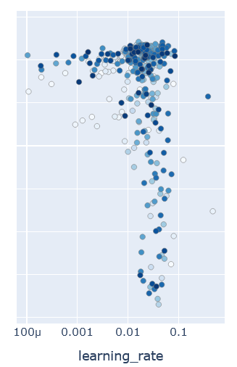
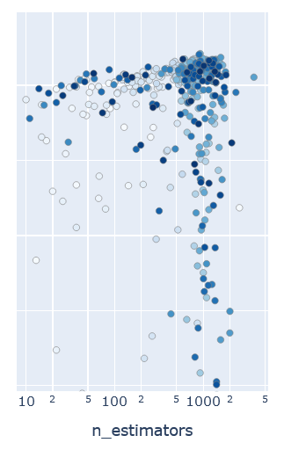
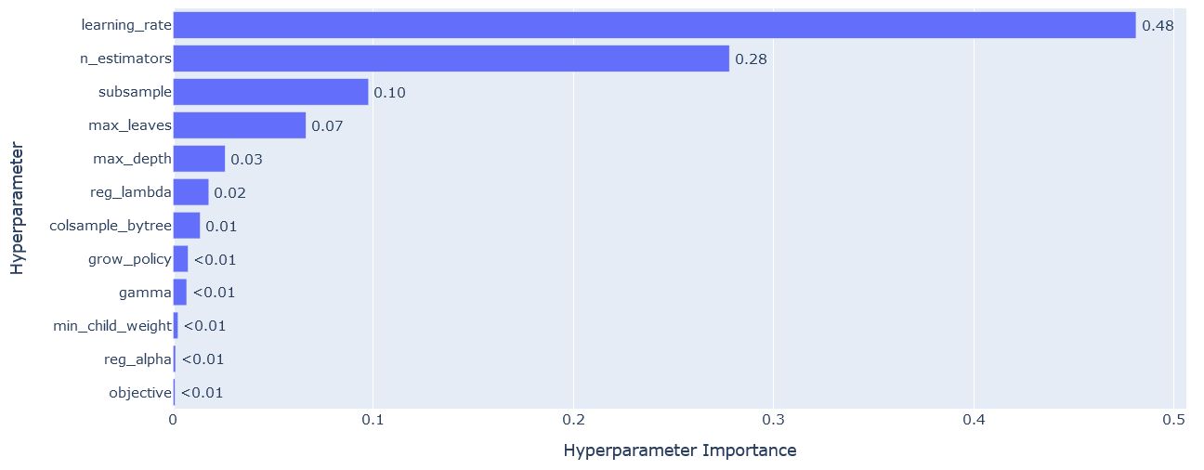
Final solution - Hyperparameters Tuning

Slide 9
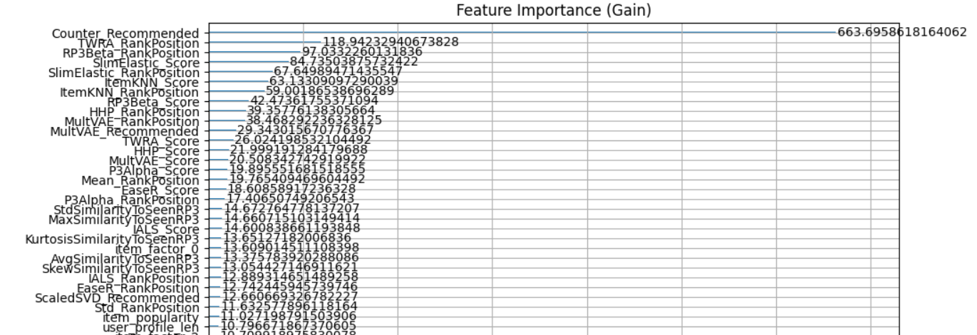
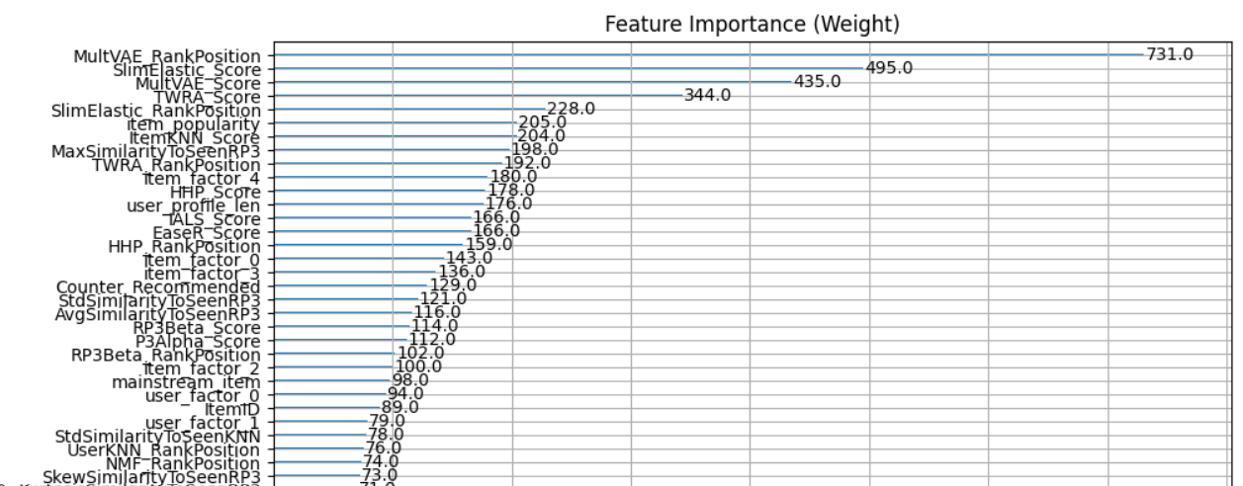
Final solution - Feature Importance
Notes:
Here we can see the importances of the features given by XGBoost. The first plot gives how much have gained the model from the features and the most important one is by far Counter Recommender, that is the sum of the recommended booleans, so overall the number of recommenders that recommended the items was very important to build the final recommendations. Other very important features are the scores and the rank positions of SlimElastic, TWRA, RP3Beta and MultVAE, which are also the ones that have the most splits as the second plot shows. Indeed, adding MultVAE and TWRA to the model have resulted in a nice improvement of the MAP (from 0.142 to > 0.143).

Slide 10
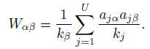
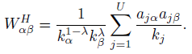
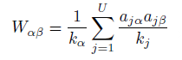
Implemented Recommenders
HHP (Hybrid HeatS ProbS):
TWRA (Two-Way Rank Aggregation):
Forward ranking: computes the score of the items for a user
Backward ranking: computes the score of the users for a item
ProbS (P3):
HeatS:
Notes:
Two algorithms that we implemented and showed not bad performances where graph approaches: Hybrid HeatS ProbS and Two Way Rank Aggregation. In particular, this second one was the second best performing single recommender after SLIM Elastic. The first combines P3 (ProbS) and HeatS, which replace the random walk by using diffusion, that is by using the out degree of the second node instead of the out degree of the first node in the denominator. The second is part of a framework that recommend users to items, it was implemented for graphs in the original paper, but it can be extended for many other approaches in our opinion. Indeed, it produces a convex combination between the forward ranking scores (that is the classic recommender system) and the backward ranking scores (that are scores for recommending users to items). For example, if we consider P3 as the base recommender, we can interpret the backward ranking as a 3 step random walk starting from an item instead of starting from a user. Similarly for P3alpha and RP3beta.

